Slide 1
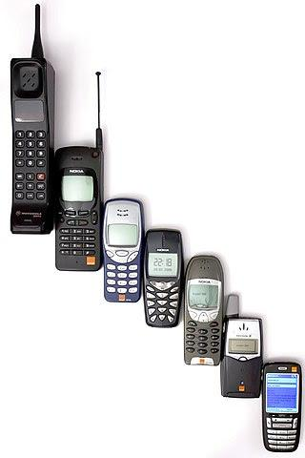
Mobile Price Range Analysis
By:
Ankita Bugga
Chaitali pandharpure

Slide 2
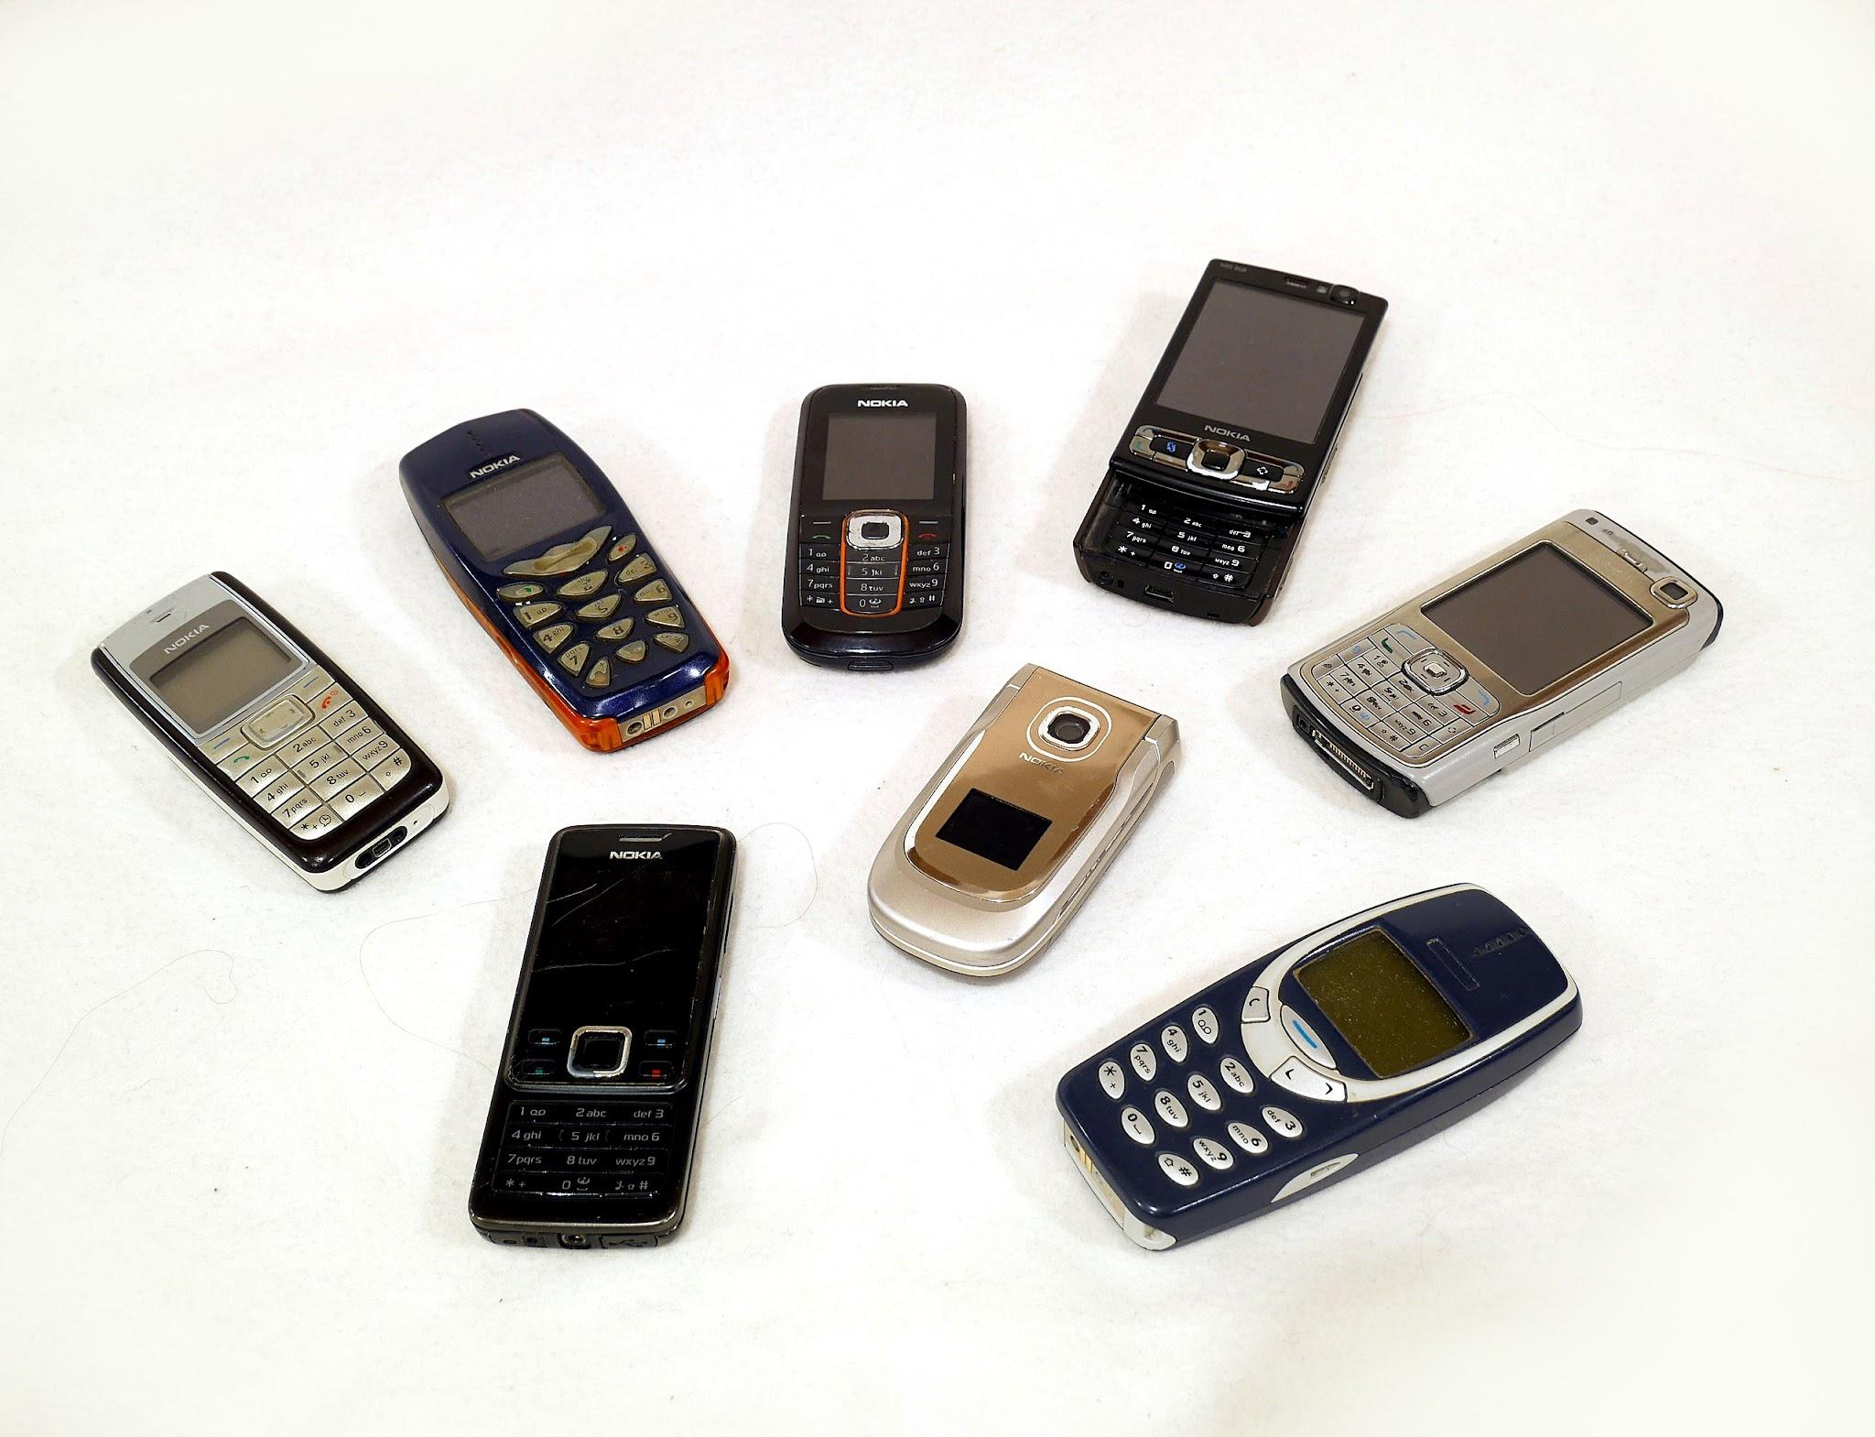
INDEX:
Importing Libraries
Data Loading
Data Cleaning
Transforming Data
Data View
Data Exploration
Filtering Outliers
Data Visualization
Conclusion

Slide 3
Problem Statement:
Purpose:
Analyzing mobile price range data can serve several important purposes:
Market Understanding: It helps understand the distribution of mobile phone prices and the market segments that different price ranges represent. This information is useful for identifying trends and preferences among consumers.
Product Positioning: Manufacturers and retailers can use this analysis to determine where to position their products in the market. For example, identifying a gap in a specific price range can help in designing and pricing new models.
Competitive Analysis: By analyzing the pricing of various mobile phones, companies can gauge their competitive standing. This involves understanding how their products compare in terms of features and pricing against competitors.
Sales Strategy: It aids in developing effective sales strategies by identifying which price ranges are more attractive to consumers. This can help in targeting marketing efforts and promotions more effectively.
Price Prediction: For businesses and investors, predictive analysis of mobile phone prices can forecast future trends and guide decisions related to investments, inventory management, and product development.
Consumer Behavior: Understanding how different features and price ranges influence consumer choices can provide valuable insights for improving product offerings and tailoring marketing strategies.
In the competitive mobile phone market, understanding how various features and specifications influence the pricing of mobile devices is crucial for manufacturers and consumers alike.

Slide 4
Objectives
The primary objectives of this project are:
The primary objectives of this project are:
To explore and understand the features of the mobile phone dataset.
To perform data preprocessing, including handling missing values and outliers.
To identify the key factors that influence mobile phone pricing.
To build predictive models that can accurately estimate mobile phone prices.
To visualize the results and present actionable insights.
Introduction
In analyzing mobile phones, several key specifications play a crucial role in defining their performance, user experience, and market positioning. Understanding these specifications helps both consumers and manufacturers make informed decisions.

Slide 5
Scope of Work
The project will involve the following tasks:
· Data Exploration: Understanding the dataset, including the features and target variable.
· Data Preprocessing: Cleaning the dataset by handling missing values, removing outliers, and normalizing/standardizing the data.
· Feature Selection: Identifying the most significant features influencing mobile price range.
· Data Visualization: Using plots and graphs to visualize the relationship between features and mobile price range .
· Interpretation of Results: Analyzing the output of the models .
· Reporting: Documenting the findings and preparing a final report.

Slide 6

Importing Libraries
pandas: Data manipulation and analysis.
numpy: Numerical computing with powerful array operations.
matplotlib: Data visualization.

Slide 7
Load Data Set
Loading the Dataset:
The pd.read_csv() function is used to load the dataset from a CSV file located at the specified path ('D:\\jn\\mobile\\train.csv').
The data is stored in a pandas DataFrame called data, which allows for easy manipulation and analysis of the dataset.

Slide 8

Data Cleaning
Step 1 : Convert Datatype
Standardizing Data:Here we are changing data types as our preferences
Vailadition Data : Convert Data types to float to boolean
Replacing value: In price range column low cost ,medium cost and high cost as well as very high cost
Step 2 :Check Missing values: We can can check missing values
#Check for missing values
missing_values = data.isnull().sum()
print(missing_values)
Step 3: Handling Duplicates :
duplicates = data.duplicated().sum()
Step 4: Save The Updated data frame to a CSV file
data.to_csv('cleaned_data1.csv', index=False)

Slide 9
Transforming Data
Load new updated file
data=pd.read_csv('D:\\jn\\mobile\\updated_data.csv')
data

Slide 10

Data View
Display basic information : print(data.info())
First few rows of the dataset: print(data.head())
To print the column names present in the dataset : data.columns
Check the shape of the DataFrame to understand its dimensions:print(data.shape)
# Outputs: (number_of_rows,number_of_columns)

Slide 11
Data Exploration
The describe() method is used to generate summary statistics of the DataFrame.
This includes measures like mean, median, standard deviation, minimum and maximum values, and quartiles for numerical columns.
print(data .describe())

Slide 12

Filtering Outliers
Unique values: Here we are finding unique values in clock_speed column
Group by 'price_range' and apply multiple aggregation functions
Smallest Value: Here we can are finding minimum value for battery_power
Largest Values :Here we can are finding maximum value for battery_power
Conditional Filtering: Example: Filter rows where battery_power is greater than 1000

Slide 13

Creating a pivot table
Pivot Table:
# Load the data from the CSV file
file_path = 'updated_data.csv' # Replace with your actual file path
df = pd.read_csv(file_path)
# Create a pivot table
# Example: Pivot table to find the average of 'px_height' and 'px_width' based on 'price_range' and 'four_g'
pivot_table = pd.pivot_table(df,
values=['px_height', 'px_width'], # Columns to aggregate
index=['price_range'], # Rows (index)
columns=['four_g'], # Columns
aggfunc='mean') # Aggregation function
.

Slide 14
Pivot Table for talk_time by price_range
pivot_table_price = pd.pivot_table(df,
values='talk_time',
index='price_range',
aggfunc='mean')
print(pivot_table_price)

Slide 15
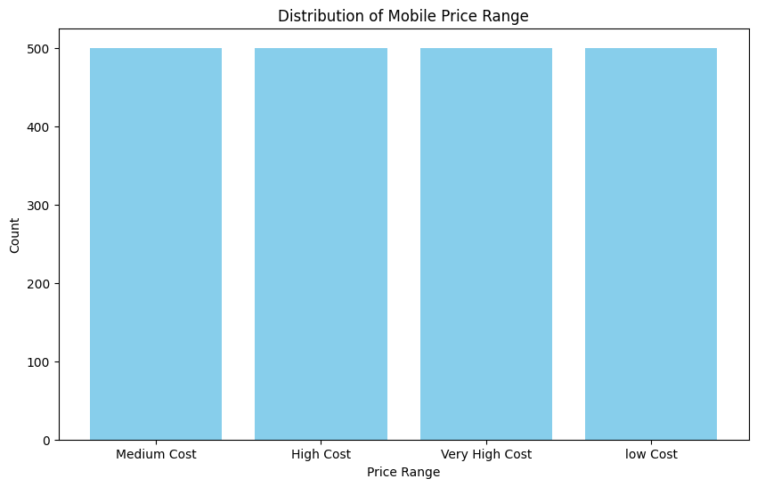
Data Visualization
Distribution of Price Range:Here We are analyzing medium cost , high cost and low cost as well as very high cost counts are counting from price range column

Slide 16
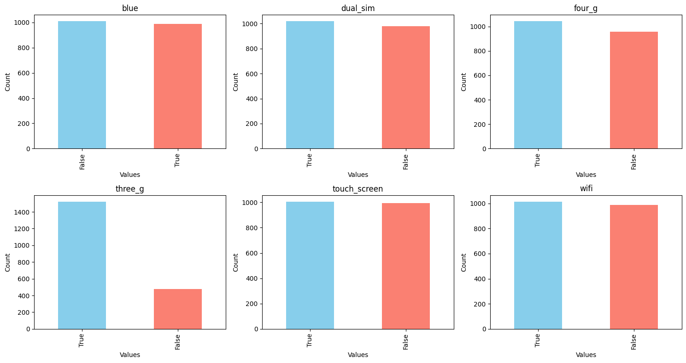
Data Visualization
Plot each Boolean column in a subplot

Slide 17
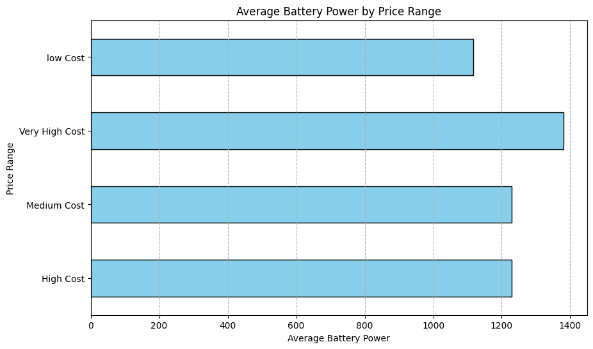
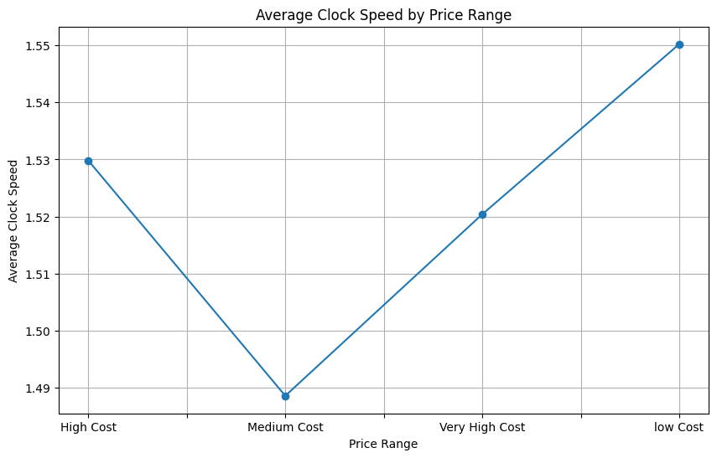
Average Clock Speed by Price Range:
Average Battery Power by Price Range:

Slide 18
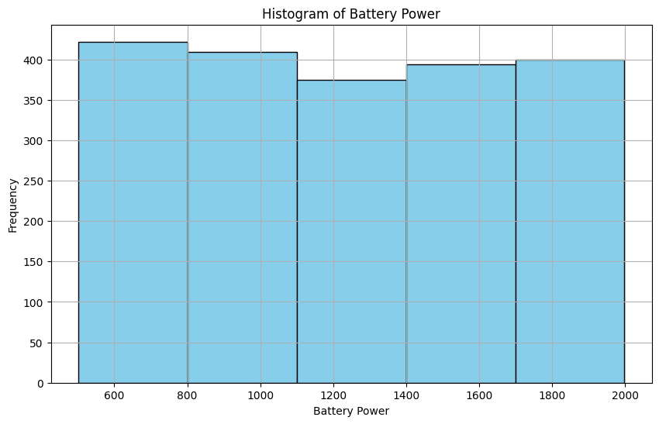
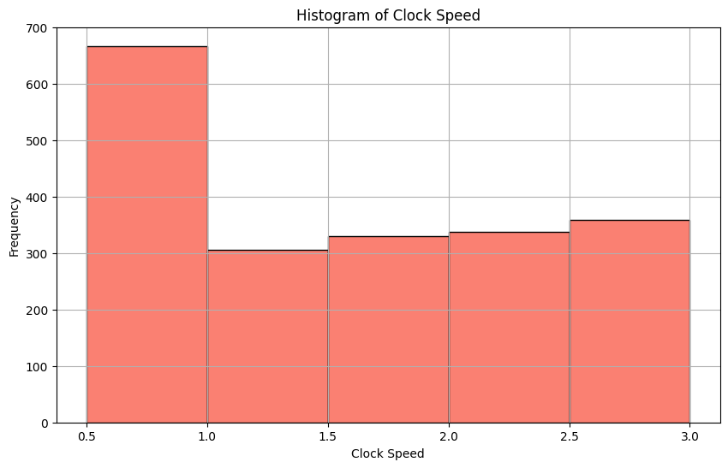
Histogram of Battery Power
Histogram of Clock Speed

Slide 19
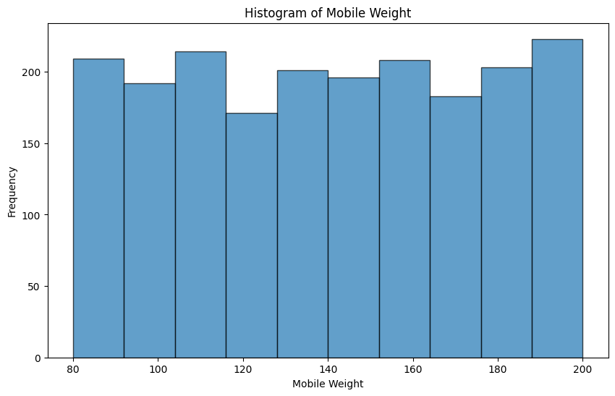
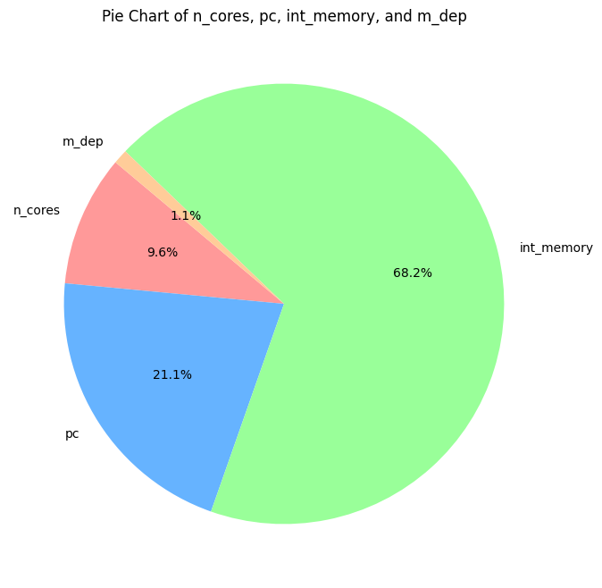
hardware component in mobile
Histogram of Mobile Weight

Slide 20
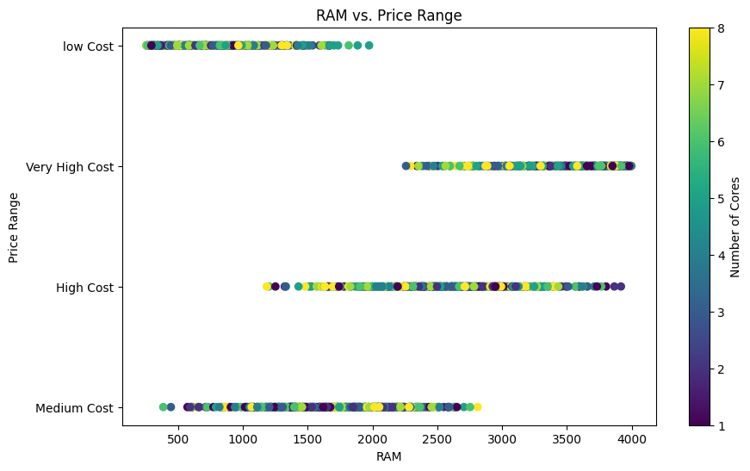
Scatter Plot: RAM vs. Price Range

Slide 21
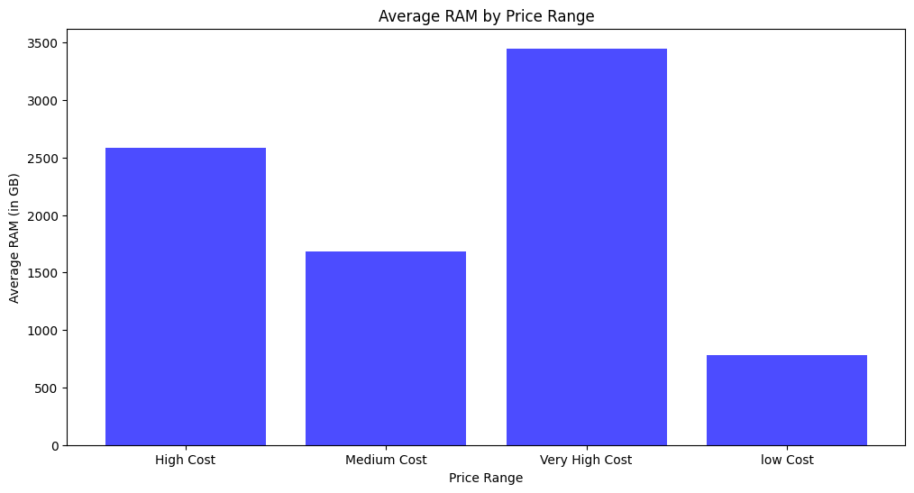
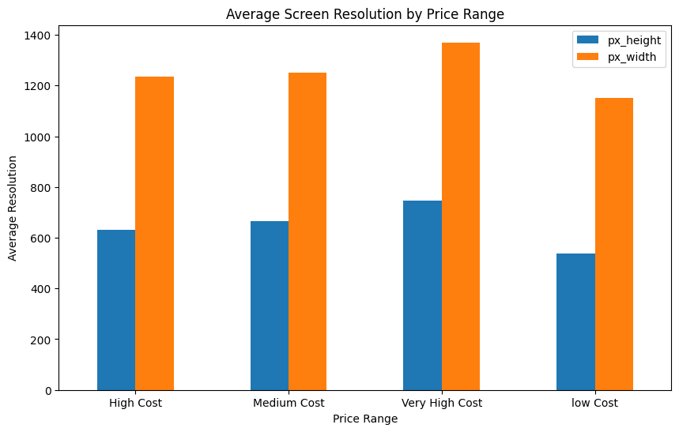
Average RAM by Price Range
How does screen resolution (px_height and px_width) vary across different price_range values?

Slide 22
Methodology
The project will follow a structured approach:
1. Data Collection: The dataset will be sourced from a kaggle website.
2. Data Preprocessing:
o Handle missing data using imputation techniques.
o Detect and remove outliers.
o standardize the data if necessary.
3. Exploratory Data Analysis (EDA):
o Use descriptive statistics to summarize the dataset.
o Create visualizations like histograms, bar char and pie chart to understand feature distributions and relationships.
4. Visualization:
o Generate charts and graphs to visualize the findings.
5. Reporting:
o Compile the analysis, results, and insights into a comprehensive report.

Slide 23
Tools and Technologies
The project will utilize the following tools and technologies:
· Programming Language: Python
· Libraries: Pandas, NumPy, Matplotlib
· IDE: Jupyter Notebook or any Python-compatible Integrated Development Environment (IDE)
· Data Source: kaggle website (mobile price range)
Expected Outcomes
· Identification of the most significant factors influencing mobile price range .
· Visualization of the data and model results to provide actionable insights for mobile industry.
· A comprehensive report documenting the analysis process, findings, and recommendations.

Slide 24
Timeline
The project is expected to be completed within a [specific timeframe, e.g., 4 weeks], with the following milestones:
· Week 1: Data Collection and Preprocessing
· Week 2: Exploratory Data Analysis and Feature Selection
· Week 3: Evaluation
· Week 4: Visualization, Reporting, and Final Submission

Slide 25

Conclusion
The dataset provides a comprehensive overview of various mobile phone specifications, allowing analysis of how features like battery power, RAM, and camera quality vary across different price ranges. This data is useful for identifying trends and making informed decisions when comparing mobile phones within specific price segments.
Practical Applications
This dataset is valuable for:
Market Analysis: Understanding the distribution of features in different price categories.
Consumer Guidance: Assisting potential buyers in comparing models based on their preferences and budget.
Product Development: Helping manufacturers identify gaps in the market and innovate accordingly.
:

